Slide 1
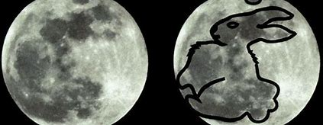
Climate change and the Moon Rabbit

Slide 2
Contents
Indroduction
Background
Objectives
Approach
Target Audience
Schools, Colleges and Universities
Learning outcomes
Use-cases

Slide 3
Moon Rabbit Intro
Moon Rabbit is a self-built, dynamic real-time CO₂ sensor designed to educate and empower communities worldwide.
It captures CO₂ readings continuously, publishing data both locally—to your mobile device or PC—and globally via an interactive map that can be interactively explored in detail.
At its core, Moon Rabbit is a programme of self-build, experimentation and self-directed learning, tailored especially for the education community.
By enabling students, educators and families to build and deploy their own Moon Rabbit devices, the project fosters environmental awareness and hands-on STEM education.
Together, we are building a community-driven, global CO₂ map to inform, inspire, and help shape a more sustainable future.

Slide 4

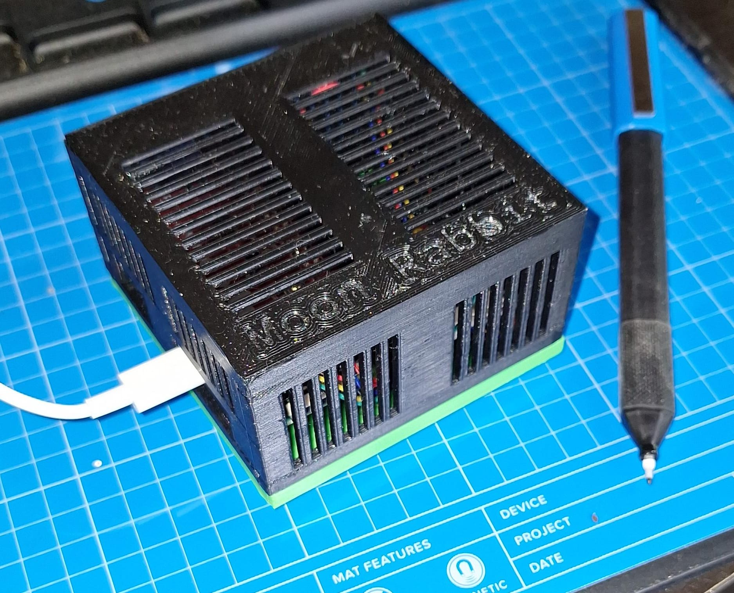
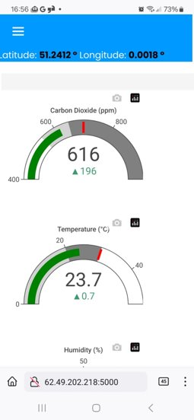
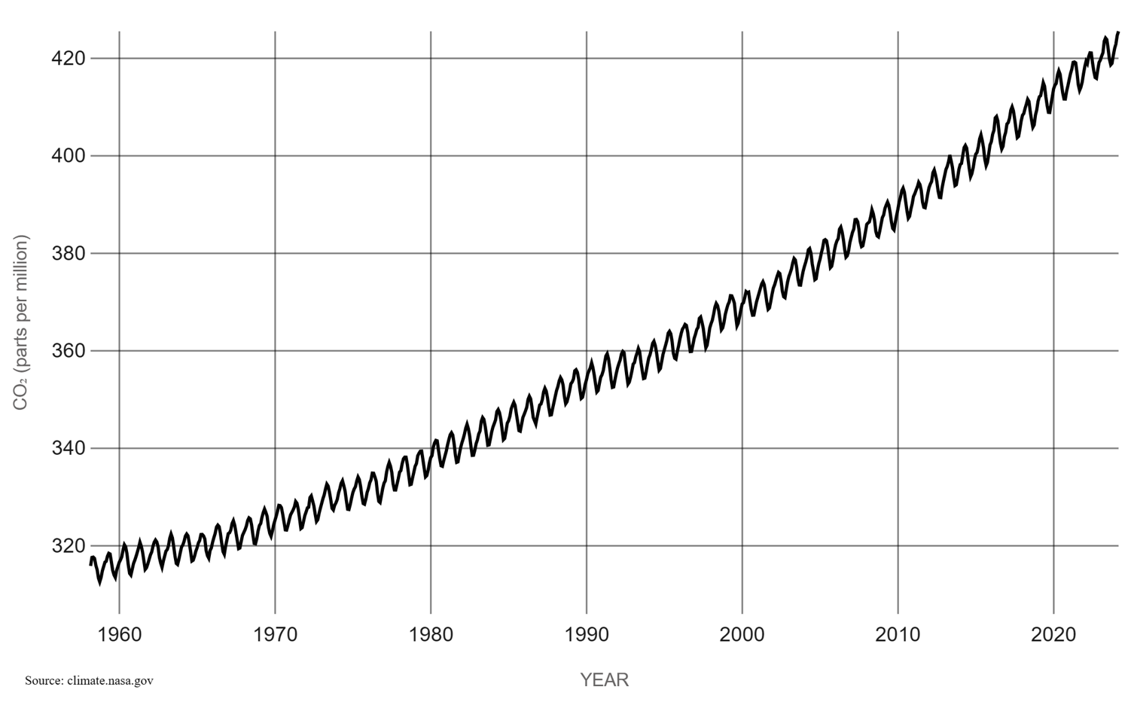
Moon Rabbit
A self-built, dynamic real-time CO₂ sensor designed to educate and empower communities worldwide.
Captures CO₂ readings continuously, publishing data to your mobile device or PC and globally via an interactive map that can be interactively explored in detail.
Moon Rabbit is a programme of self-build, experimentation and self-directed learning, tailored for the education community.
By enabling students, educators and families to build and deploy their own Moon Rabbit devices, the project fosters environmental awareness and hands-on STEM education.
Together, we are building a community-driven, global CO₂ map to inform, inspire, and help shape a more sustainable future.
Kyoto
Protocol
Atmospheric
CO₂
Paris
Accord

Slide 5
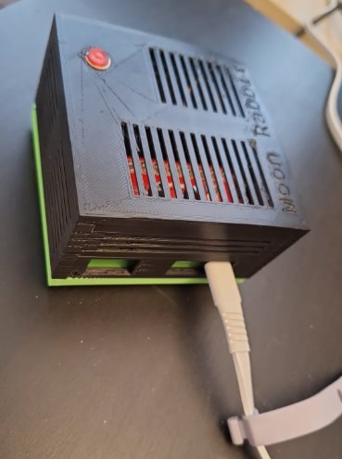
Moon Rabbit
The Moon Rabbit legend is a popular part of local folklore throughout Asia. It may be found in diverse cultures in China, Japan, Korea, Sri Lanka, Cambodia, Thailand, Vietnam, Myanmar and even Mexico.
Stories are told about the brave rabbit that was rewarded and honoured for his courage and can now be seen on the moon.
That's 4 billion potential climate supporters.

Slide 6
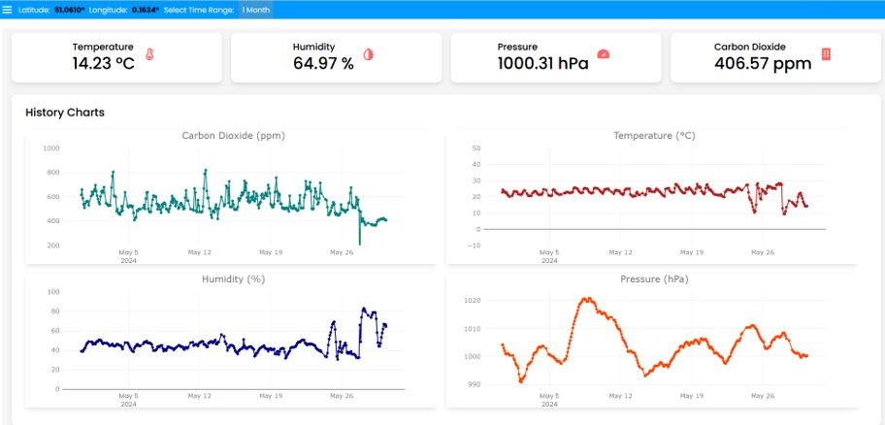
A local CO₂dashboard

Slide 7
Background - CO₂ Concentration for last 65 years
From Mauna Loa Observatory in Hawaii from 1958 to 2023.
Concentration in parts per million (ppm).
Seasonal variations about 8 ppm.
Annual growth about 2 ppm.
LATEST MEASUREMENT (NASA):
June 2024​: 426.9 ppm. The highest ever.
Kyoto
Protocol
Paris
Accord

Slide 8

Background - 1896
Swedish Professor Svante Arrhenius published his epoch-defining paper:
“On the influence of Carbonic Acid in the Air upon the Temperature of the Ground”.

Slide 9
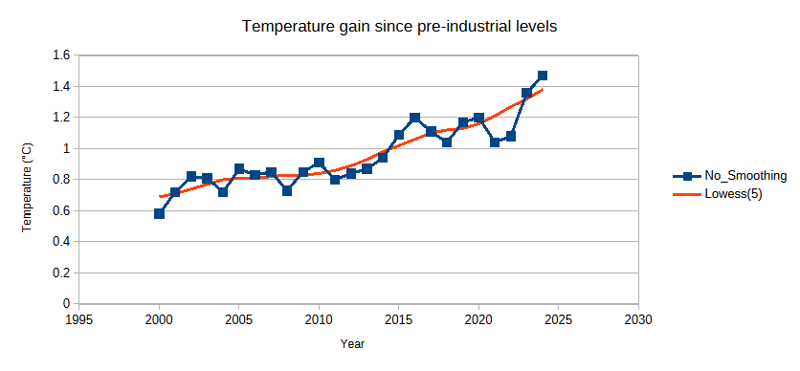
Recent global temperatures

Slide 10
The half-life of CO₂ is 120 years.
Carbon dioxide has a half-life of about 120 years.
Trees and plants absorb about 35%.
Oceans dissolving the remaining 65% (but warming oceans dissolve less).
If we stopped all CO₂ output today, half of our carbon debt would still be there in 2148.

Slide 11
Objectives
Short term – this year
Longer Term
Pilot 5 Moon Rabbit projects in schools
Create links with industry bodies (eg STEM Organisation, MET Office etc)
Receive grand for funding
Upgrade website from PoC to MVP
50 members of community
Moon Rabbit in other countries and continents
Supporting policy change
Global network of Moon Rabbit users
Change vocabulary of debate – eg carbon debt, paying our fair share.

Slide 12
Approach
Build pilot community
1
Perform outreach at schools
Get industry bodies and partners on board
2
Recruit members
3
Build website
Apply for funding
Schedule events on Eventbright
4

Slide 13
Target Audience
Schools, Colleges and Universities
STEM Organisations
Weather Organisations (eg MET Office)
Local Government (Councils etc)
Industry partners

Slide 14
Schools, Colleges and Universities
Support Assemblies
Supplied with list of items and guide to build Moon Rabbits (eg Amazon list)
Optional pre-built units or components
Written guides & videos

Slide 15
Learning Outcomes – no initial skills needed Participants gain hands-on experience and a broad range of interdisciplinary skills
Design and engineering through 3D printing
Electronics and construction, learning soldering and assembly of the device
Technical Skills – installing and configuring hardware and software
Programming in Python and web design for the CO₂ capture/web readouts
Accuracy and calibration of CO₂ measurement (vacuum pumps etc)
Environmental awareness and the effect of CO₂ on temperature and climate
Numeracy and data analysis - applying statistics to interpret collected data meaningfully
Applied Psychology, creating standardised tests (eg does student performance or behaviour in the classroom vary with CO₂ levels?)

Slide 16
Examples of other use-cases
2) Children's perfomance/behaviour in a classroom with high vs low CO₂
3) Urban versus rural living
4) Gas or oil central heating
5) Living near an industrial area
6) Year-on-year change of CO₂
Phone page

Slide 17
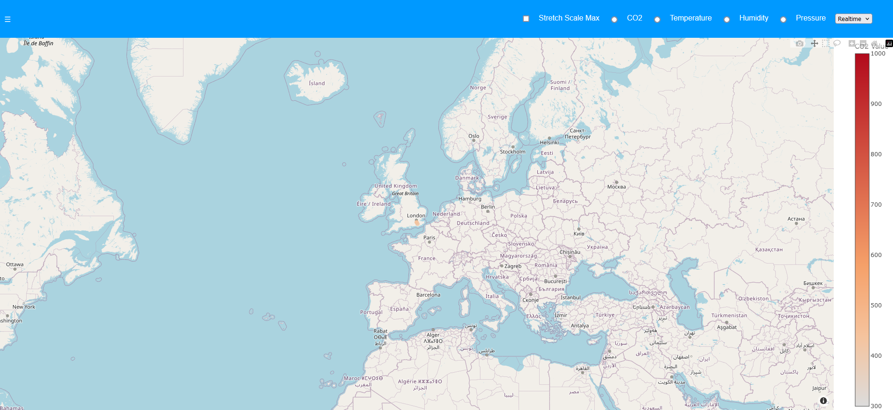
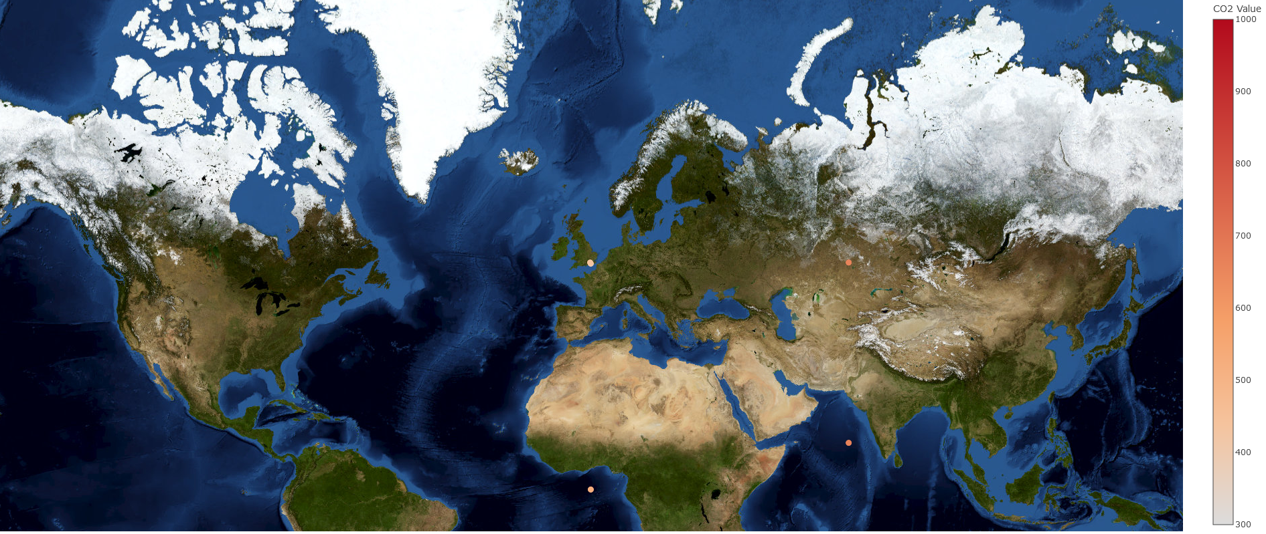
Proof of concept "global CO₂ map showing Moon Rabbit devices" - this will grow
<- Dinosaurs
<- Giant
Anteaters

Slide 18
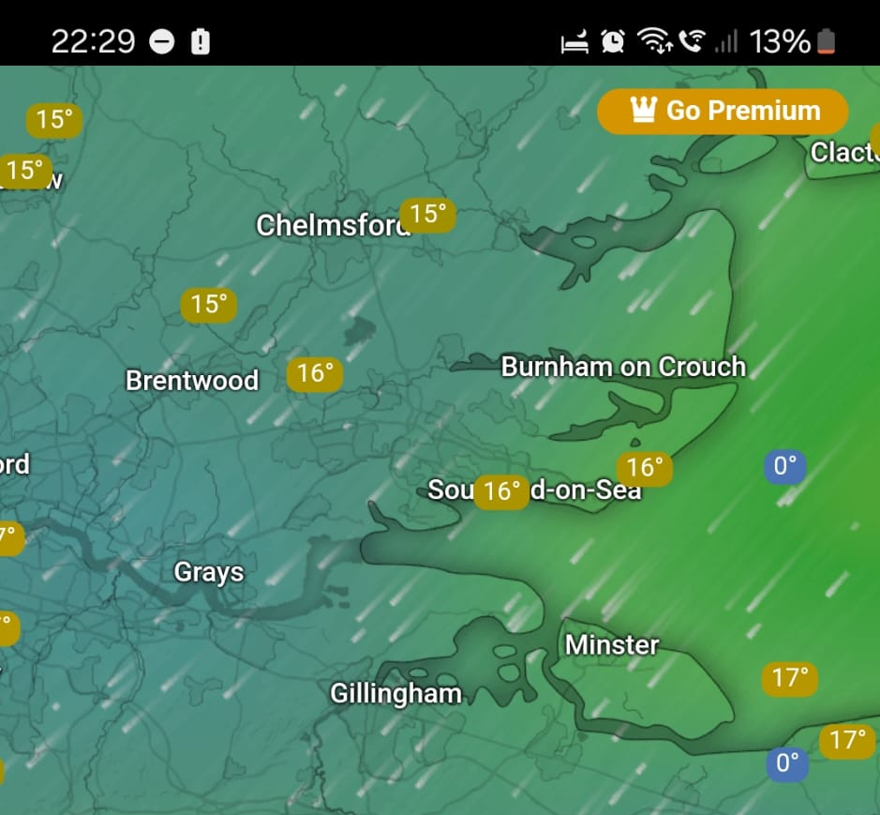
Sharing Weather Data between schools and regions
Like Windy

Slide 19
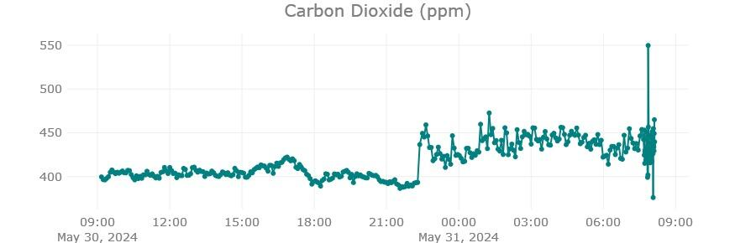
CO₂ use case 1) - Living near a road
I wish I'd had a webcam recording it.

Slide 20
How will this help?
This is just the first step: getting people involved and informing them.
Next, armed with data, communicate, reach out, spread the word, websites, influencers, social media;
Then write to democratic representatives and directors of companies and institutions influence the debate.
Finally: innovate, tax on emitters, carbon capture, replanting the Sahara or artificially cooling the ocean.

Slide 21
The future done right.
Either way, at the end of this, if we survive, it's a massive economic boom for the winners;
Huge excitement: this is like a space-race for the whole planet.
We're going to just need a lot of new technologies and it's a massive opportunity for everyone, because it's an advance that affects the whole world.
A cleaner Earth could be better Earth.

Slide 22
A call to participate
The Moon Rabbit costs about £125 in parts from the UK to build a bit less if you order from China. Plus you need to calibrate it.
You can make one yourself (you'll need a 3D printer and soldering iron).
You'll need a waterproof, outside space with mains supply and Wi-Fi or Network.

Slide 23
Questions?

